Slide 1
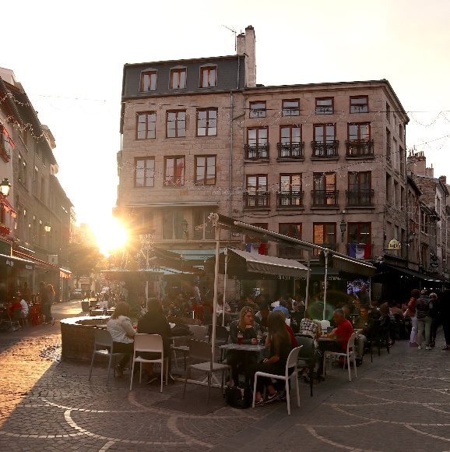

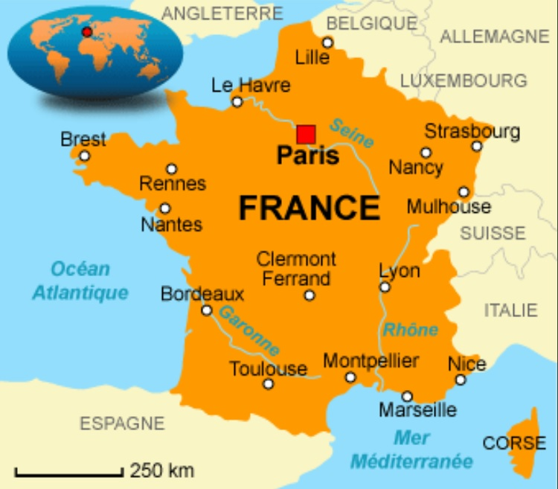
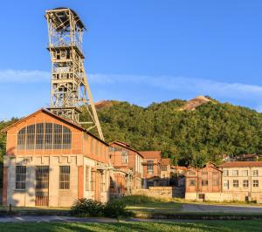
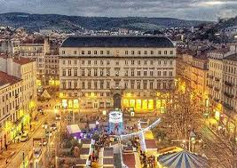
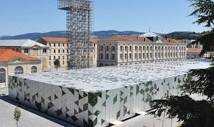
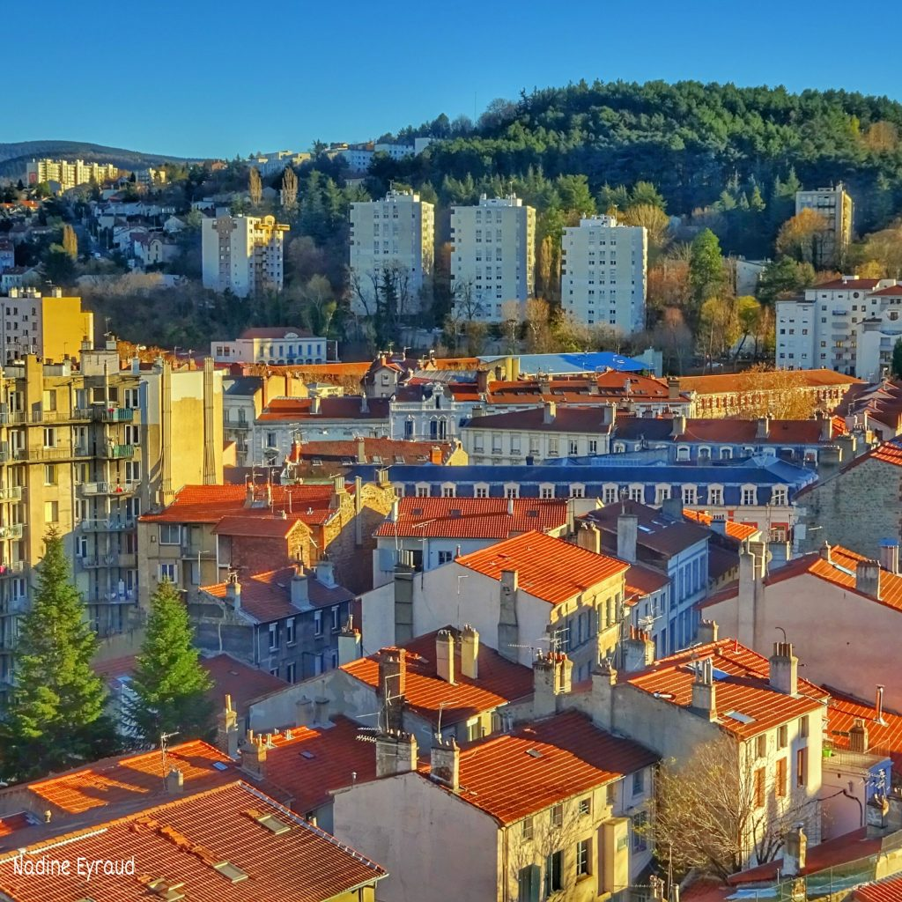
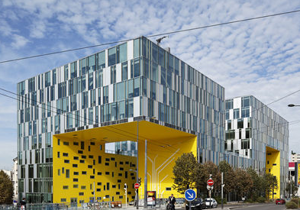
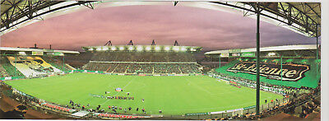

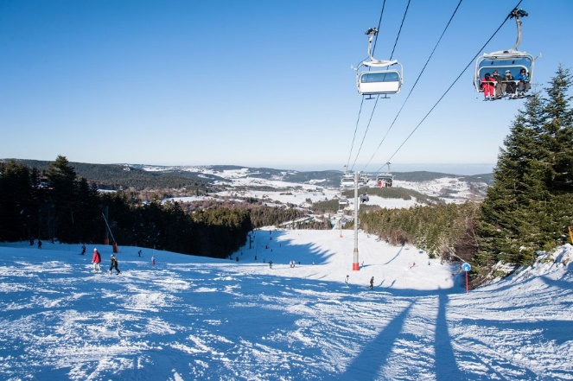
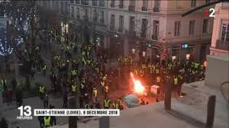
Saint-Étienne

Slide 2
Overview of the SPARQL-Generate language and latest developments
Maxime Lefrançois
Maxime.Lefrancois@emse.fr
http://maxime-lefrancois.info/
MINES Saint-Étienne – Institut Henri Fayol
Laboratoire Hubert Curien UMR CNRS 5516
Notes:
"Ouverture, décentralisation sont des caractéristiques essentielles de l’industrie du futur dans laquelle l’Internet des Objets, l’Intégration de données et de services sont de plus en plus présents«
"Interopérabilité sémantique est un verrou à lever pour la mise en place d’échanges de données entre acteurs hétérogènes, pour fournir une abstraction des données captées sur laquelle différents raisonnements puissent être mis en place"

Slide 3








2005
2008
2009
2010
2014
2017
Agrégation in mechanical engineering
M2 Signal processing
M2 Computer science
Knowledge representation and reasoning
Ph.D. KRR applied to linguistics
Semantic Web and interoperabiliity
Semantic Web and Web of data
Semantic Interoperability on the Web of Thing
Maxime Lefrançois
Maxime.Lefrancois@emse.fr
http://maxime-lefrancois.info/
MINES Saint-Étienne – Institut Henri Fayol
Laboratoire Hubert Curien UMR CNRS 5516

Slide 4




Connected Intelligence Team Hubert Curien Laboratory https://connected-intelligence.univ-st-etienne.fr/
Saint-Étienne
13 permanent staff members – 11 Ph.D. students (2 open pos. 2020) – 1 postdoc (2 open pos. now)
Contact: Olivier.Boissier@emse.fr

Slide 5
Saint-Étienne

Slide 6
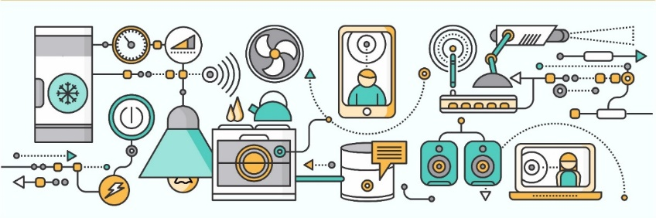

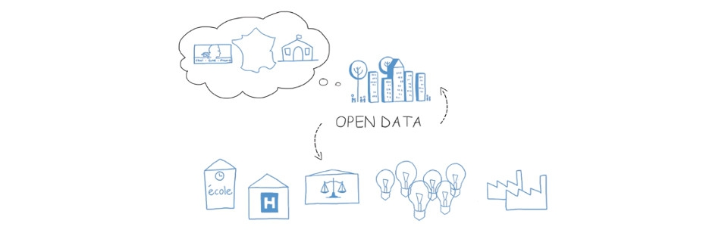
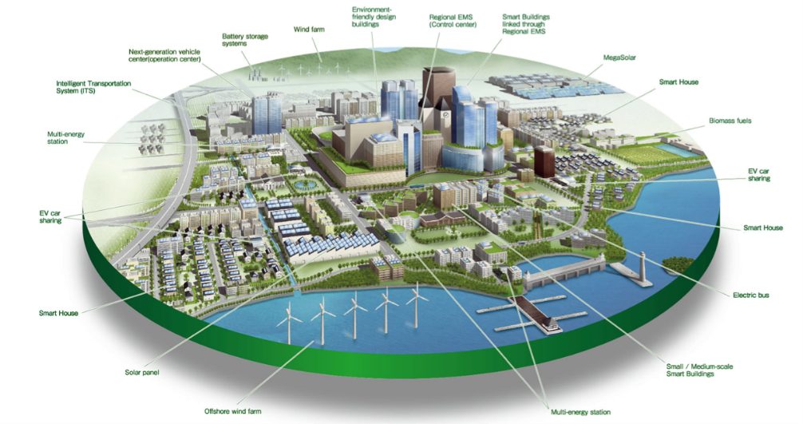

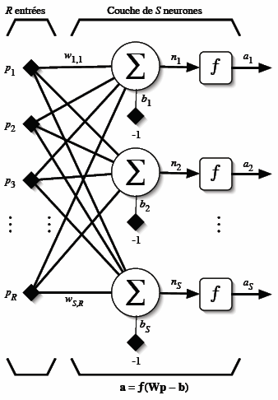
How to reach semantic interoperability at the data level between heterogeneous things and services?
Smart Things
Humans
Services
Data

Slide 7










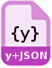

There is a multitude of data formats/models on the Web

Slide 8

Key step: generate some RDF
M. Lefrançois, A. Zimmermann, N. Bakerally, A SPARQL extension for generating RDF from heterogeneous formats,
In Proc. Extended Semantic Web Conference, 2017
+ EKAW, Hackatons, ESWC Tutorial 2018, PFIA Tutorial 2019, OEG Tutorial ☺

Slide 9
Requirements for RDF generation
Transform multiple sources …
... having heterogeneous formats
Be extensible to new data formats
Be easy to use by Semantic Web experts
Integrate in a typical semantic web engineering workflow
Be flexible and easily maintainable
Contextualize the transformation with an RDF Dataset
Modularize / decouple / compose transformations
Enable data transformation, aggregates, filters, ...
Generate RDF Lists
Performant
Transform binary formats as well as textual formats
Transform big documents (output HDT)
Generate RDF streams from streams
M. Lefrançois, A. Zimmermann, N. Bakerally, A SPARQL extension for generating RDF from heterogeneous formats,
In Proc. Extended Semantic Web Conference, 2017
+ EKAW, Hackatons, ESWC Tutorial 2018, PFIA Tutorial 2019, OEG Tutorial ☺

Slide 10
Existing approaches
RDFizers (see https://www.w3.org/wiki/ConverterToRdf )
A lot of tools are specific to one or a few formats (44 referenced formats)
Some frameworks support several/many formats
ad hoc methods,
little or no control on the structure of the output
=> may require an additional transformation
M. Lefrançois, A. Zimmermann, N. Bakerally, A SPARQL extension for generating RDF from heterogeneous formats,
In Proc. Extended Semantic Web Conference, 2017
+ EKAW, Hackatons, ESWC Tutorial 2018, PFIA Tutorial 2019, OEG Tutorial ☺

Slide 11
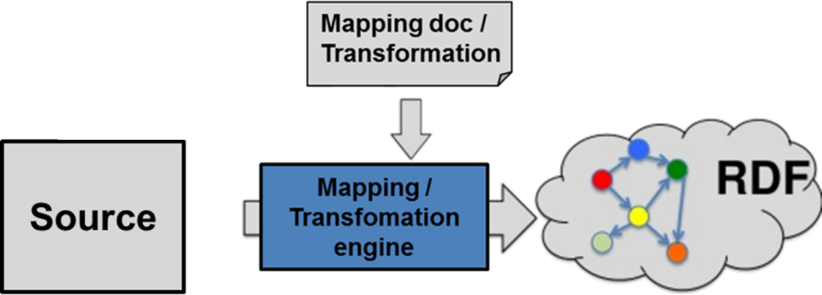
Existing approaches
Approaches based on mapping/transformation languages
M. Lefrançois, A. Zimmermann, N. Bakerally, A SPARQL extension for generating RDF from heterogeneous formats,
In Proc. Extended Semantic Web Conference, 2017
+ EKAW, Hackatons, ESWC Tutorial 2018, PFIA Tutorial 2019, OEG Tutorial ☺

Slide 12
GRDDL
<html xmlns=http://www.w3.org/1999/xhtml
xmlns:grddl='http://www.w3.org/2003/g/data-view#'
grddl:transformation="http://example.com/getAuthor.xsl" >
<head>
<title>Are You Experienced?</title>
[...]
</html>
<album xmlns:grddl='http://www.w3.org/2003/g/data-view#'
grddl:transformation="http://example.org/getAlbum.xsl" >
<artist mbid="">The Jimi Hendrix Experience</artist>
<name>Are You Experienced?</name>
...
</album>
(W3C REC 2007)

Slide 13
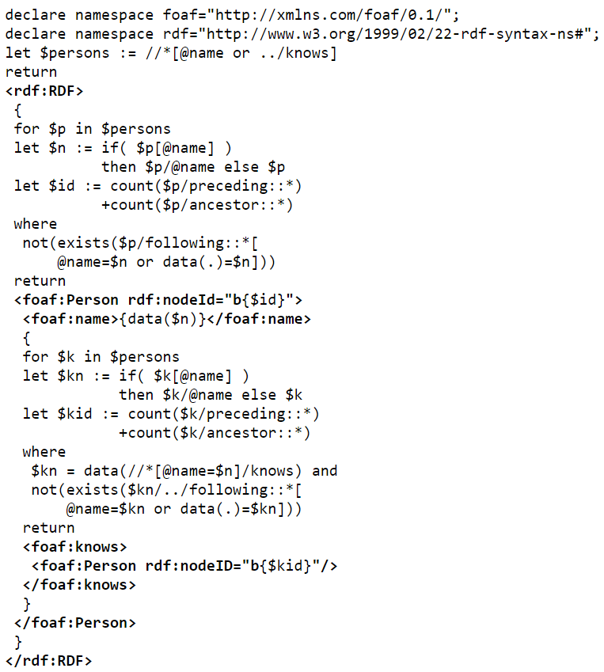
XSPARQL
(W3C member submission 2009)

Slide 14
R2RML
(W3C REC 2012)
<#TriplesMap2>
rr:logicalTable <#DeptTableView>;
rr:subjectMap [
rr:template "http://data.example.com/department/{DEPTNO}";
rr:class ex:Department;
];
rr:predicateObjectMap [
rr:predicate ex:name;
rr:objectMap [ rr:column "DNAME" ];
];
rr:predicateObjectMap [
rr:predicate ex:location;
rr:objectMap [ rr:column "LOC" ];
];
rr:predicateObjectMap [
rr:predicate ex:staff;
rr:objectMap [ rr:column "STAFF" ];
].

Slide 15
CSVW
{
"@context": ["http://www.w3.org/ns/csvw", {"@language": "en"}],
"url": "tree-ops.csv",
"dc:title": "Tree Operations",
"dcat:keyword": ["tree", "street", "maintenance"],
"dc:publisher": {
"schema:name": "Example Municipality",
"schema:url": {"@id": "http://example.org"}
},
"dc:license": {"@id": "http://opendefinition.org/licenses/cc-by/"},
"dc:modified": {"@value": "2010-12-31", "@type": "xsd:date"},
"tableSchema": {
"columns": [{
"name": "GID",
"titles": ["GID", "Generic Identifier"],
"dc:description": "An identifier for the operation on a tree.",
"datatype": "string",
"required": true
}, {
"name": "on_street",
"titles": "On Street",
"dc:description": "The street that the tree is on.",
"datatype": "string"
}, {
"name": "species",
"titles": "Species",
"dc:description": "The species of the tree.",
"datatype": "string"
}, {
"name": "trim_cycle",
"titles": "Trim Cycle",
"dc:description": "The operation performed on the tree.",
"datatype": "string"
}, {
"name": "inventory_date",
"titles": "Inventory Date",
"dc:description": "The date of the operation that was performed.",
"datatype": {"base": "date", "format": "M/d/yyyy"}
}],
"primaryKey": "GID",
"aboutUrl": "#gid-{GID}"
}
}
(W3C REC 2015)

Slide 16
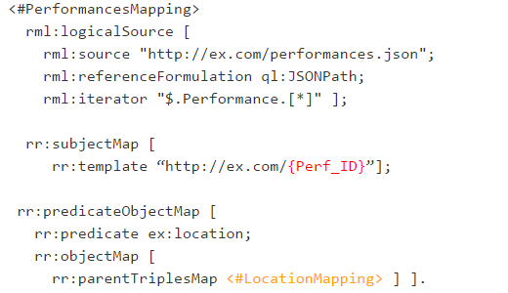
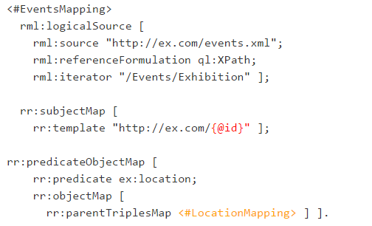
RML + Extensions
(Dimou et al., 2013)

Slide 17
RML + Extensions – covers the REQs?
(Dimou et al., 2013)
Transform multiple sources …
... having heterogeneous formats
Be extensible to new data formats
Be easy to use by Semantic Web experts
Integrate in a typical semantic web engineering workflow
Be flexible and easily maintainable
Contextualize the transformation with an RDF Dataset
Modularize / decouple / compose transformations
Enable data transformation, aggregates, filters, ...
Generate RDF Lists
Performant
Transform binary formats as well as textual formats
Transform big documents (output HDT)
Generate RDF streams from streams
Subject-centric?
Include parts from different sources in one RDF Term?

Slide 18
Main research questions
How to design a mapping language that…
…is expressive enough to cover all of our use cases?
…is still rather simple to use?
…can be easily extended to any source format?

Slide 19
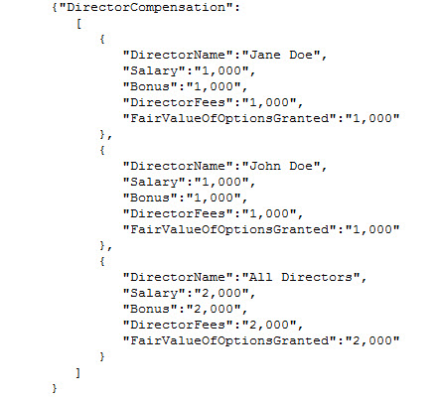
RDF generation process

Slide 20
RDF generation process
Selection patterns Xpath, JSONpath, CSS selectors, regex, etc.

Slide 21
RDF generation process
Selection patterns Xpath, JSONpath, CSS selectors, regex, etc.

Slide 22
RDF generation process
ex:Director
rdf:type
foaf:name
?
ex:salary
?
ex:fee
?
Selection patterns Xpath, JSONpath, CSS selectors, regex, etc.
Graph pattern definition

Slide 23
RDF generation process
ex:Director
rdf:type
foaf:name
?
ex:salary
?
ex:fee
?
Selection patterns Xpath, JSONpath, CSS selectors, regex, etc.
Graph pattern definition
+ Select ontologies

Slide 24
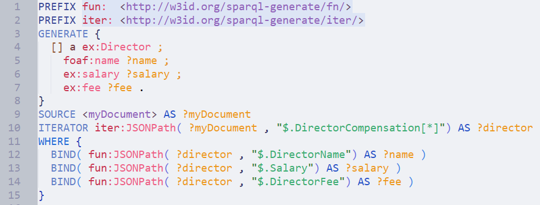
First SPARQL-Generate query
ex:Director
rdf:type
foaf:name
?
ex:salary
?
ex:fee
?
+ Select ontologies
Selection patterns Xpath, JSONpath, CSS selectors, regex, etc.
Graph pattern definition

Slide 25
The Graph Pattern Definition is here
ex:Director
rdf:type
foaf:name
?
ex:salary
?
ex:fee
?
+ Select ontologies
Selection patterns Xpath, JSONpath, CSS selectors, regex, etc.
Graph pattern definition

Slide 26
Query RDF Dataset + « Documentset »
ex:Director
rdf:type
foaf:name
?
ex:salary
?
ex:fee
?
+ Select ontologies
Selection patterns Xpath, JSONpath, CSS selectors, regex, etc.
Graph pattern definition

Slide 27
Iterator Functions
ex:Director
rdf:type
foaf:name
?
ex:salary
?
ex:fee
?
+ Select ontologies
Selection patterns Xpath, JSONpath, CSS selectors, regex, etc.
Graph pattern definition

Slide 28
Binding Functions (that’s standard SPARQL)
ex:Director
rdf:type
foaf:name
?
ex:salary
?
ex:fee
?
+ Select ontologies
Selection patterns Xpath, JSONpath, CSS selectors, regex, etc.
Graph pattern definition

Slide 29
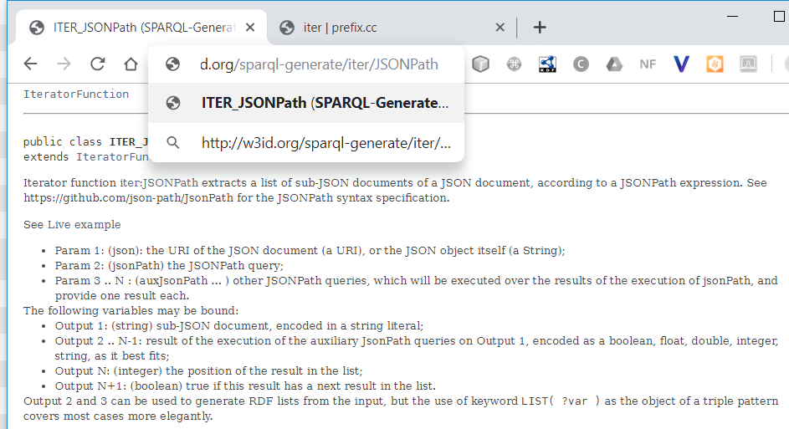
iter&fun functions have dereferenceable URIs
ex:Director
rdf:type
foaf:name
?
ex:salary
?
ex:fee
?
+ Select ontologies
Selection patterns Xpath, JSONpath, CSS selectors, regex, etc.
Graph pattern definition

Slide 30
It extends SPARQL, so we got for free ...
Implementable on top of existing SPARQL engines
Easy to learn when you know SPARQL
You get to know SPARQL better when you use SPARQL-Generate
Output template (Basic Graph Pattern) is not subject-centric
SPARQL 1.1 FILTER BIND OPTIONAL,...
SPARQL 1.1 Standard binding functions and operators
STR LANG LANGMATCHES DATATYPE BOUND IRI URI BNODE RAND ABS CEIL FLOOR ROUND CONCAT SUBSTR STRLEN REPLACE UCASE LCASE ENCODE_FOR_URI CONTAINS STRSTARTS STRENDS STRBEFORE STRAFTER YEAR MONTH DAY HOURS MINUTES SECONDS TIMEZONE TZ NOW UUID STRUUID MD5 SHA1 SHA256 SHA384 SHA512 COALESCE IF STRLANG STRDT sameTerm isIRI isURI isBLANK isLITERAL isNUMERIC REGEX + * / = > < || &&
SPARQL 1.1 Binding functions extension mechanism
SPARQL 1.1 ORDER LIMIT OFFSET
SPARQL 1.1 GROUP BY, HAVING, Aggregate functions
COUNT SUM MIN MAX AVG SAMPLE GROUP_CONCAT
ex:Director
rdf:type
foaf:name
?
ex:salary
?
ex:fee
?
+ Select ontologies
Selection patterns Xpath, JSONpath, CSS selectors, regex, etc.
Graph pattern definition

Slide 31
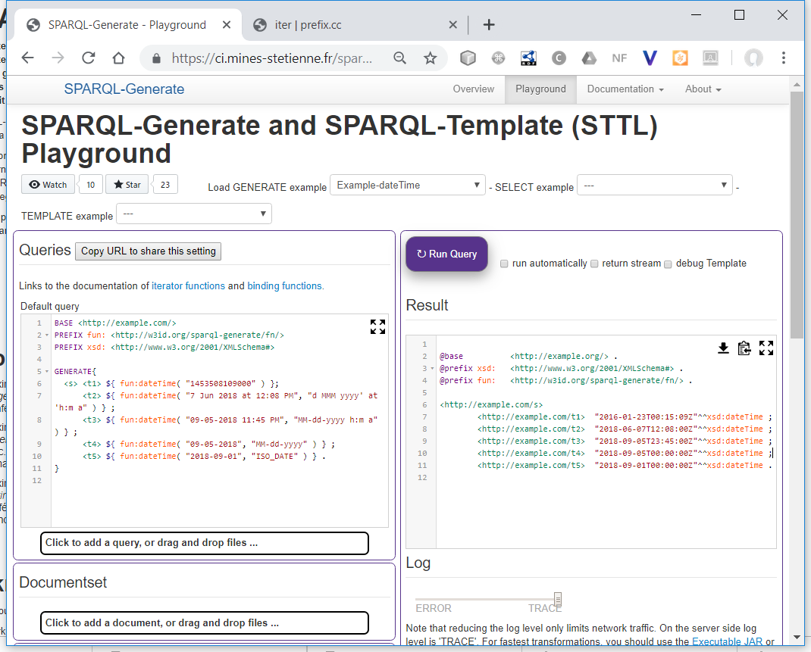
SPARQL-Generate is not just « theoretically cool »
https://w3id.org/sparql-generate/
Open-source Licence Apache 2.0 implementation based on Apache Jena financed by ITEA, ANR, ENGIE
Expressive, Perfomant, extensible to other formats
API (available on Maven Central)
JAR
Web playground + tutorial
M. Lefrançois, A. Zimmermann, N. Bakerally, A SPARQL extension for generating RDF from heterogeneous formats,
In Proc. Extended Semantic Web Conference, 2017
+ EKAW, Hackatons, ESWC Tutorial 2018, PFIA Tutorial 2019, OEG Tutorial ☺

Slide 32
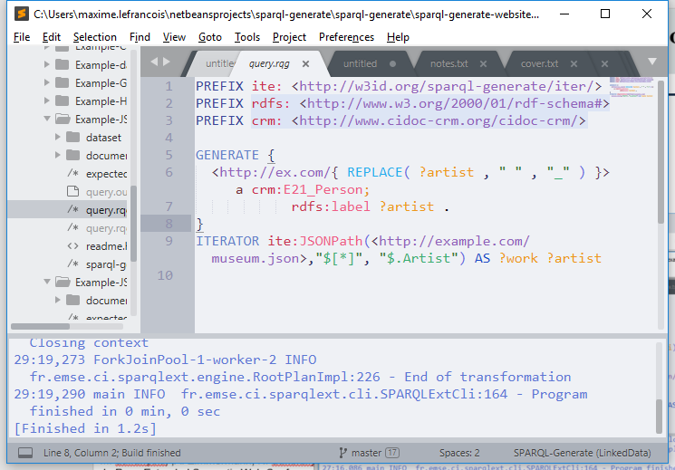
SPARQL-Generate is not just « theoretically cool »
https://w3id.org/sparql-generate/
Open-source Licence Apache 2.0 implementation based on Apache Jena financed by ITEA, ANR, ENGIE
Expressive, Perfomant, extensible to other formats
API (available on Maven Central)
JAR
Web playground + tutorial
Sublime Text package
M. Lefrançois, A. Zimmermann, N. Bakerally, A SPARQL extension for generating RDF from heterogeneous formats,
In Proc. Extended Semantic Web Conference, 2017
+ EKAW, Hackatons, ESWC Tutorial 2018, PFIA Tutorial 2019, OEG Tutorial ☺

Slide 33
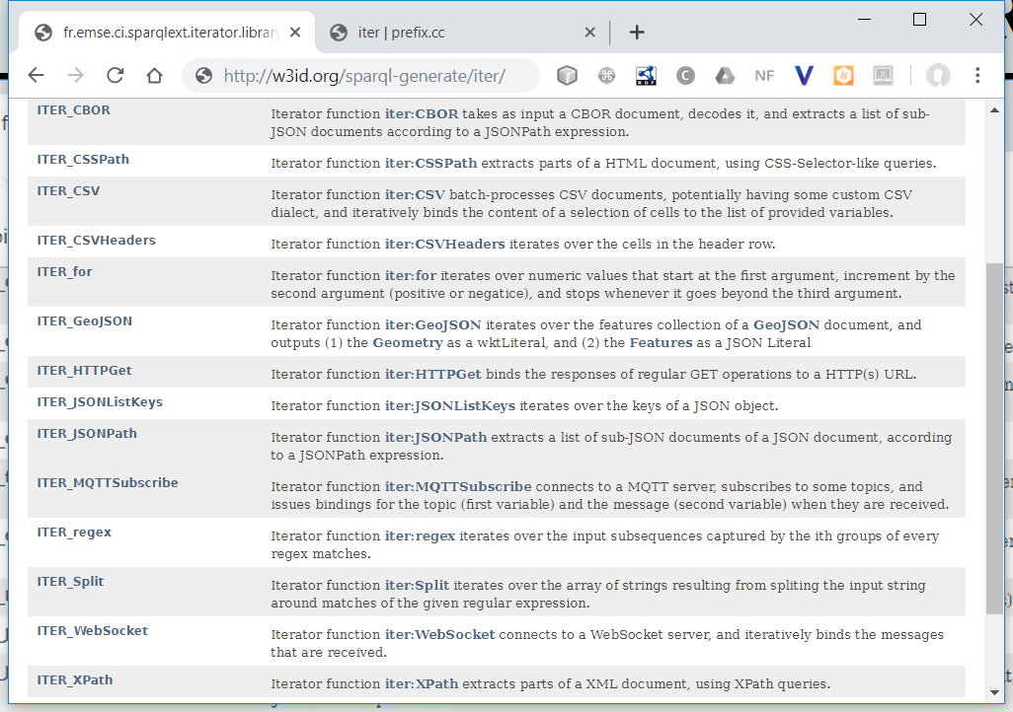
Functions have dereferenceable URIs
ex:Director
rdf:type
foaf:name
?
ex:salary
?
ex:fee
?
+ Select ontologies
Selection patterns Xpath, JSONpath, CSS selectors, regex, etc.
Graph pattern definition

Slide 34
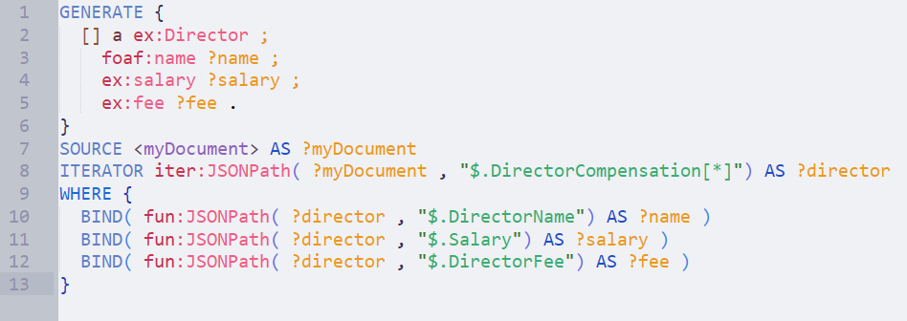
How are we going so far?
ex:Director
Transform multiple sources …
... having heterogeneous formats
Be extensible to new data formats
Be easy to use by Semantic Web experts
Integrate in a typical semantic web engineering workflow
Be flexible and easily maintainable
Contextualize the transformation with an RDF Dataset
Modularize / decouple / compose transformations
Enable data transformation, aggregates, filters, ...
Generate RDF Lists
Performant
Transform binary formats as well as textual formats
Transform big documents (output HDT)
Generate RDF streams from streams
Subject-centric?
Include parts from different sources in one literal?
rdf:type
foaf:name
?
ex:salary
?
ex:fee
?
+ Select ontologies
Selection patterns Xpath, JSONpath, CSS selectors, regex, etc.
Graph pattern definition

Slide 35
There’s more than SOURCE and ITERATOR ...
What I didn’t tell yet...

Slide 36
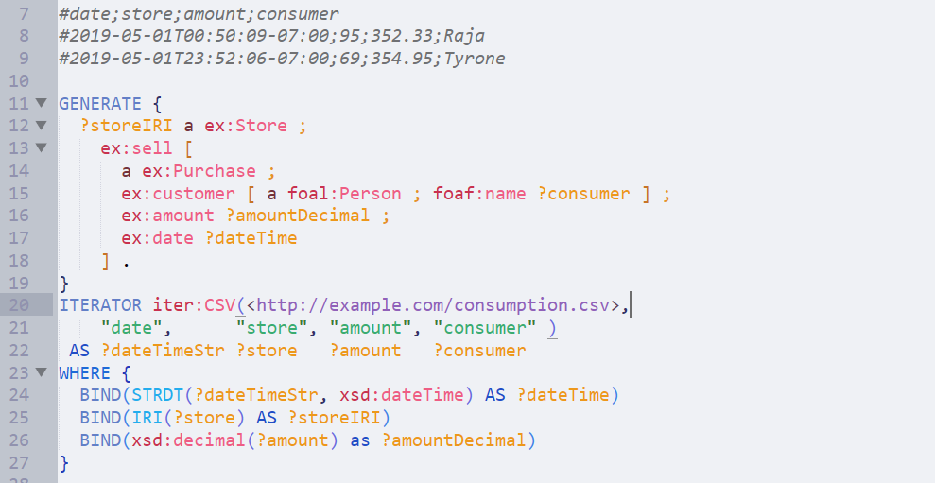
Iterators can bind several variables

Slide 37
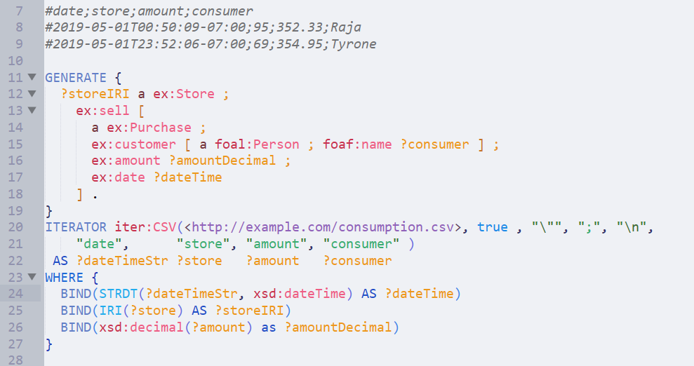
Iterators can be more powerful than that

Slide 38
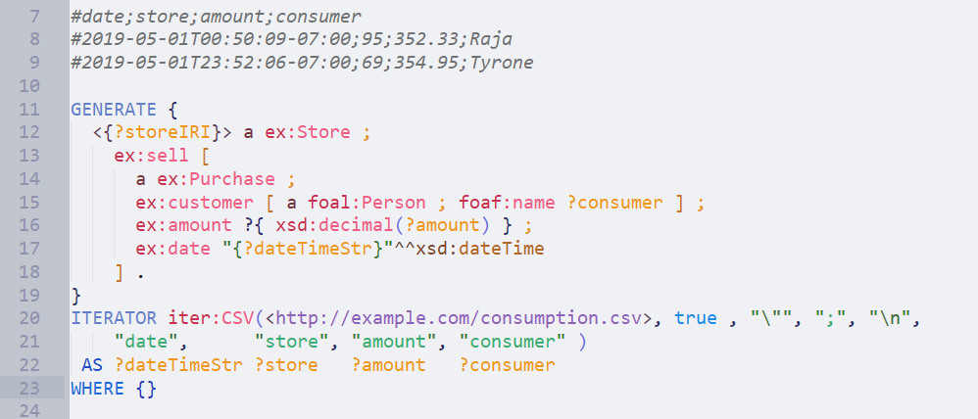
Syntactic sugar helps to compact queries

Slide 39
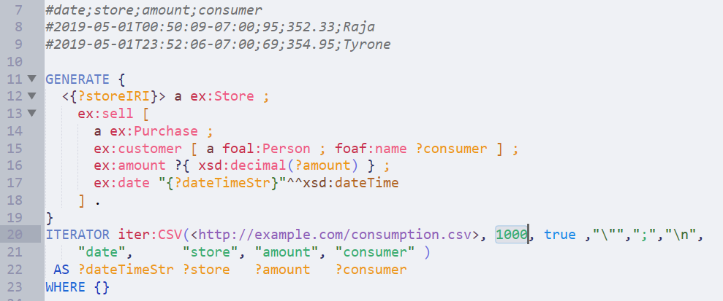
Iterators work in batches

Slide 40
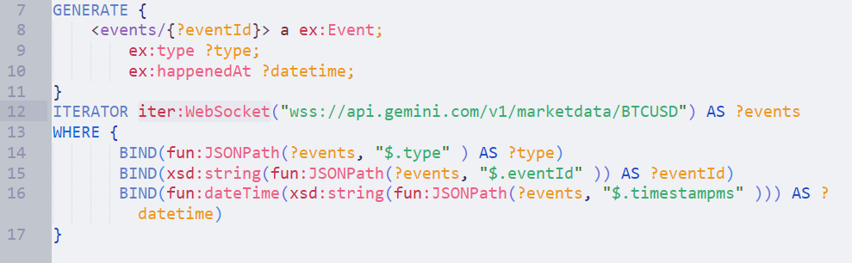
Iterators work in batches

Slide 41
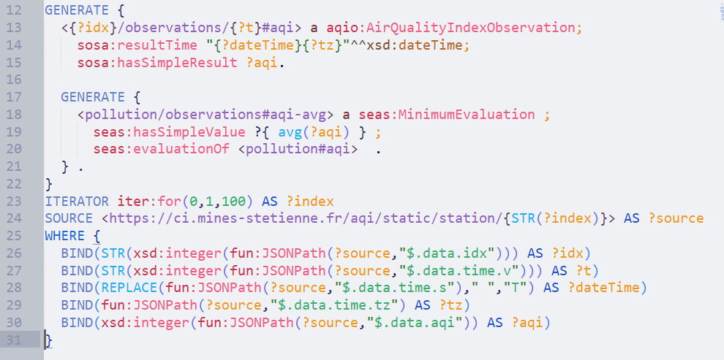
Generate clauses can be nested

Slide 42
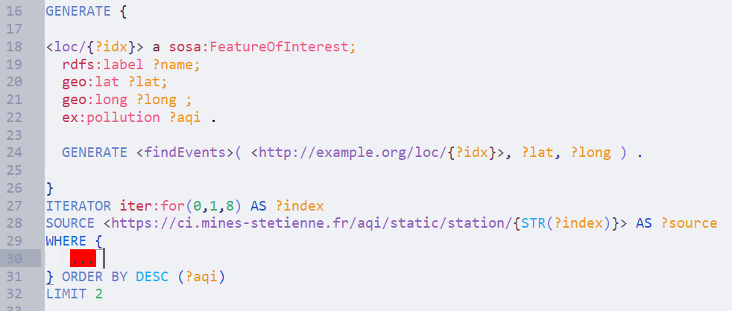
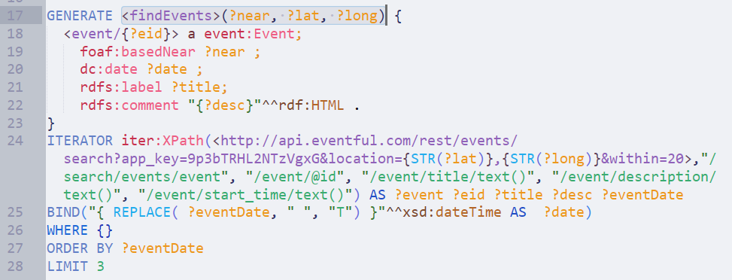
Generate queries can be modularized

Slide 43
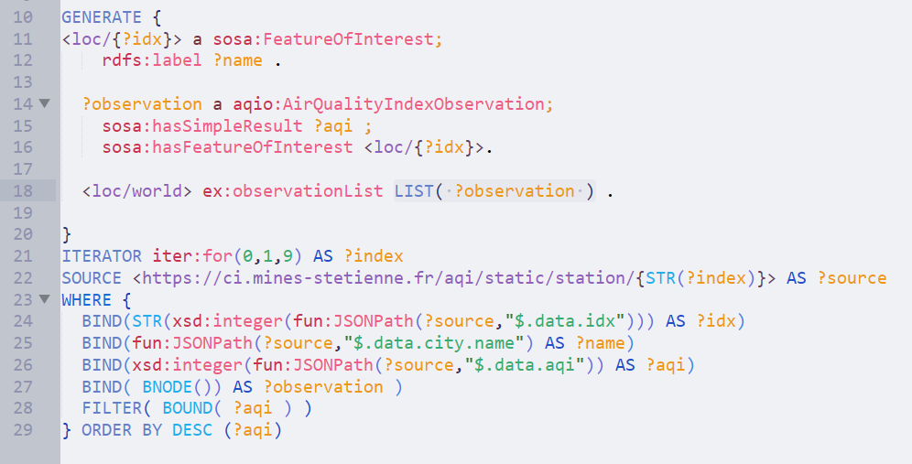
One can generate RDF lists easily*
* NEW!

Slide 44
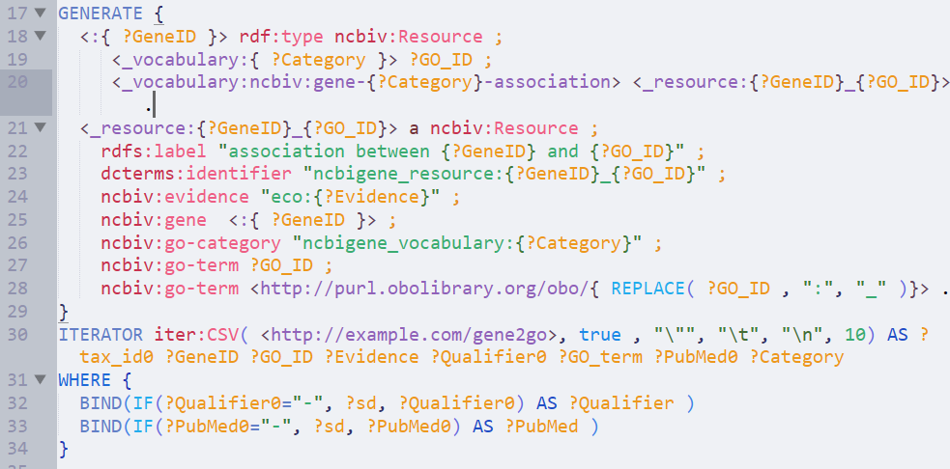
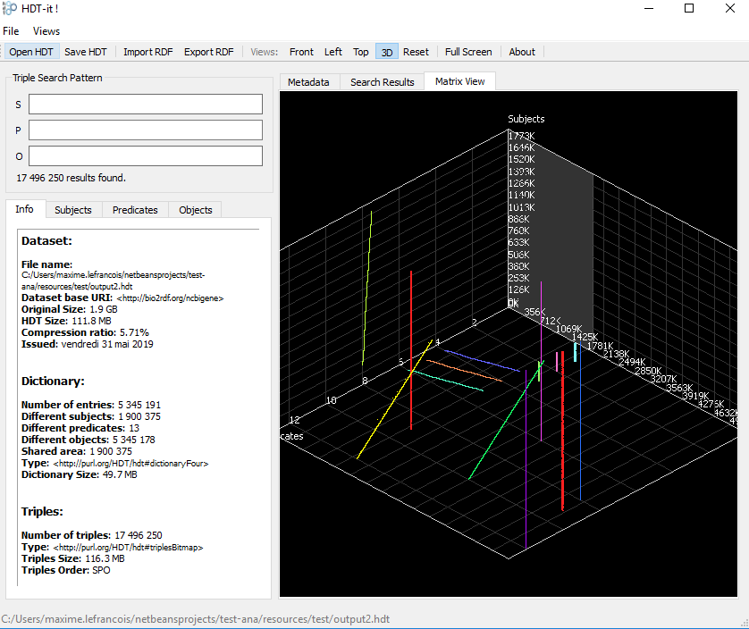
One can generate HDT directly*
* NEW!
20 seconds for a 20 MB gene2go sample, output is 17 MB of HDT
9 min, 20 sec for a 145 MB gene2go sample, output is "only" 114 MB HDT

Slide 45
There’s more than GENERATE ...
What I didn’t tell yet...

Slide 46
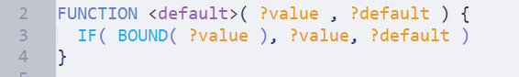
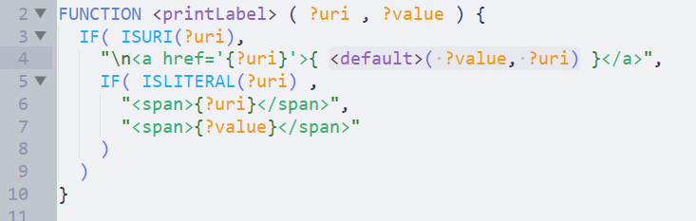
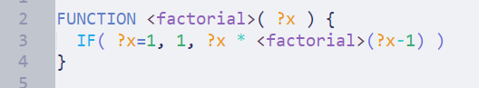
FUNCTION
Functions on RDF terms, RDF graphs or SPARQL results
Subset of LDScript: a Linked Data Script Language
http://ns.inria.fr/sparql-extension/
Olivier Corby, Catherine Faron-Zucker and Fabien Gandon, LDScript: a Linked Data Script Language, ISWC 2017, spotlight paper

Slide 47
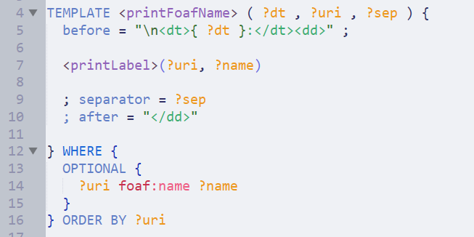
TEMPLATE
Generate Text from RDF
Extended subset of STTL: the SPARQL Template Transformation Language
https://ns.inria.fr/sparql-template/
Elements FORMAT GROUP BOX
Binding function st:call-template(templateURI, param1, param2, ...)
Olivier Corby and Catherine Faron-Zucker. A Transformation Language for RDF based on SPARQL. Web Information Systems
and Technologies - Selected Extended Papers from WEBIST 2015. Springer-Verlag, 2015. Best paper nominee.

Slide 48
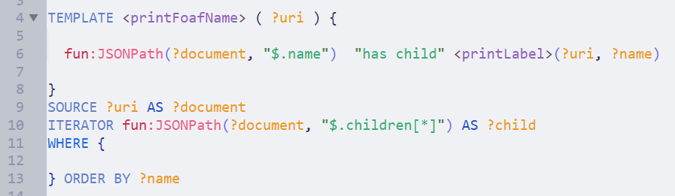
TEMPLATE
Generate Text from RDF
Extended subset of STTL: the SPARQL Template Transformation Language
https://ns.inria.fr/sparql-template/
Elements FORMAT GROUP BOX also SPARQL-Generate clauses ITERATOR SOURCE
Binding function st:call-template(templateURI, param1, param2, ...)
Olivier Corby and Catherine Faron-Zucker. A Transformation Language for RDF based on SPARQL. Web Information Systems
and Technologies - Selected Extended Papers from WEBIST 2015. Springer-Verlag, 2015. Best paper nominee.

Slide 49
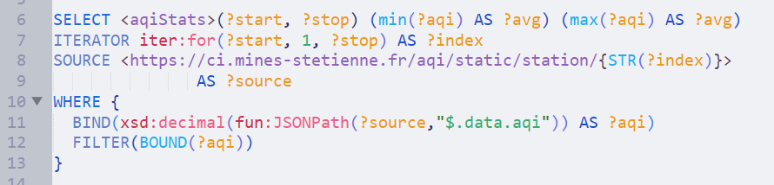
SELECT
SPARQL Select:
- with SPARQL-Generate clauses ITERATOR SOURCE
- with syntactic sugar, etc.

Slide 50
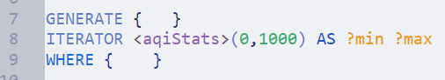
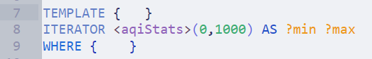
SELECT
SPARQL Select:
- with SPARQL-Generate clauses ITERATOR SOURCE
- with syntactic sugar, etc.
SELECT queries output a list of solution bindings …
… Like ITERATOR clauses

Slide 51
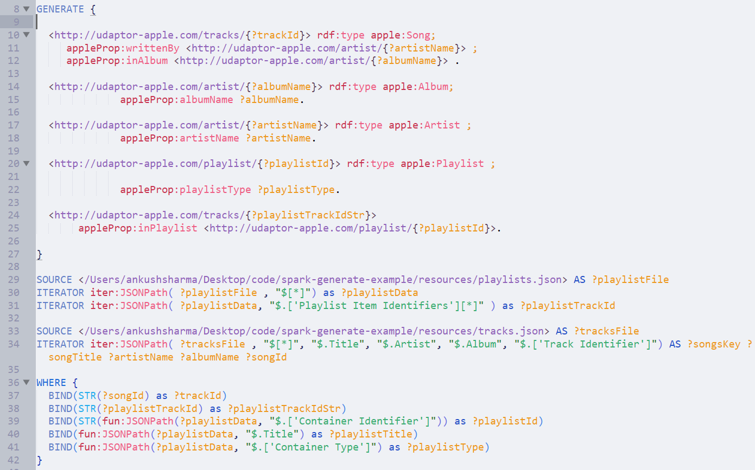
Use ITERATORS in sequence?
Let’s give you an idea of how an unoptimized query looks like

Slide 52
Use ITERATORS in sequence?
Let’s give you an idea of how an unoptimized query looks like
GENERATE queries output RDF Graph …
…

Slide 53
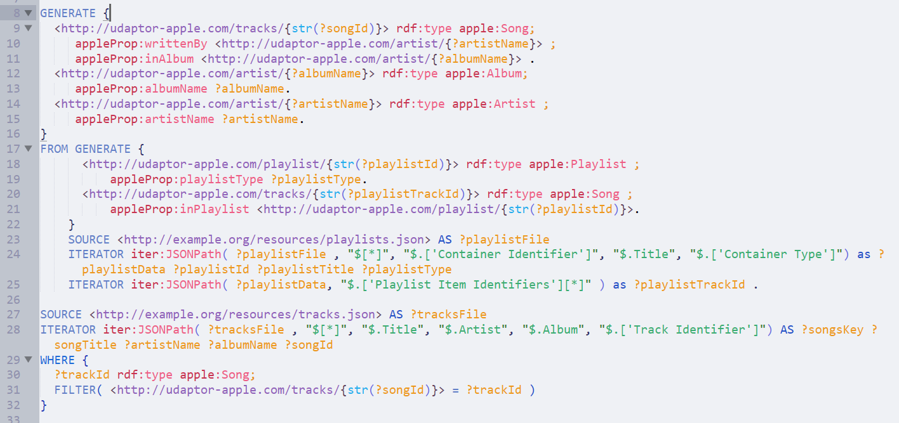
Calling a GENERATE query
FROM GENERATE {} and FROM GENERATE <>(param1, param2, …)
GENERATE queries output RDF Graph …
… like FROM Clauses

Slide 54
Modularize, Decouple, Compose queries
GENERATE
can call
TEMPLATE
can call
can call
can call
can call
SELECT
can call
FUNCTION

Slide 55
There’s much more to do than « just use it »
What I didn’t tell yet...

Slide 56
There’s much more to do than « just use it »
Two use cases that drove recent development
Generation of documentation from an ontology
Generation of an ontology from configuration (RDF or files)
Use it
On the web, as JAR, in Sublime Text, as API
Extend with your own functions and iterators (e.g., NER)
Make students play with it
Ask for help, contribute, report issues, propose enhancements https://github.com/sparql-generate/sparql-generate/issues

Slide 57
There’s much more to do than « just use it »
Ideas
How can SPARQL-Generate be compared to / used with RML?
How can SPARQL-Generate be used by Helio?
What query optimization techniques for SPARQL-Generate?
Can we use (a subset of) SPARQL-Generate for OBDA?
Can we qualify transformations w.r.t the input/output space?
Can we identify/compute operators on these objects? e.g., If input conforms to a schema, then does the output conforms to a SHACL shape?

Slide 58
What was the main purpose ...
What I didn’t tell yet...

Slide 59

Can we use RDF as a lingua franca?

Slide 60
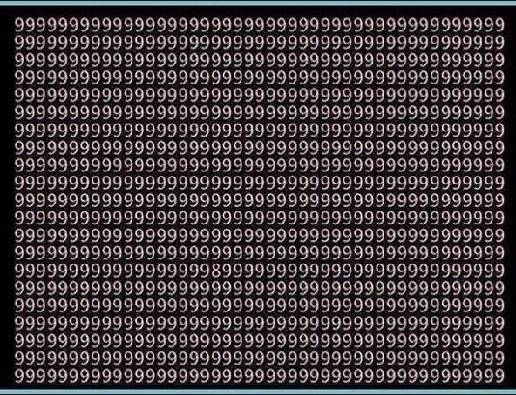

Idea: just send RDF!
application/rdf+xml
text/turtle
application/ld+json
…
ERI
HDTQ
RDF data formats will never be the only ones on the web
Developers prefer JSON, …

Slide 61
Idea: just send RDF! JSON-LD!
Solution:
to rely on *one* RDF syntax like JSON-LD
Requires:
Global adoption of JSON-LD
Maintaining during the development or the evolution phase
Utopian
Abstract data model
(ontology)
+ RDF validation: SHACL/SHeX
JSON-LD Context
+ JSON validation: JSON Schema

Slide 62


Approx. modeling of the communication between heterogeneous agents on the Web.
send
X
sender wants to send some content
e.g., state of a resource
medium
receiver
M. Lefrançois, RDF presentation and correct content conveyance for legacy services and the web of things. In Proc. IOT'18

Slide 63

Approx. modeling of the communication between heterogeneous agents on the Web.
send
X
received
X
1
2
3
Generates a representation of the content
Transmits
the message via the internet
Decodes and get understanding
sender wants to send some content
e.g., state of a resource
medium
receiver
M. Lefrançois, RDF presentation and correct content conveyance for legacy services and the web of things. In Proc. IOT'18

Slide 64
Approx. modeling of the communication between heterogeneous agents on the Web.
send
X
received
X
1
2
3
Generates a representation of the content
Transmits
the message via the internet
Decodes and get understanding
sender
medium
receiver
Correct Content Conveyance iif:
all of the essential characteristics of the content is encoded in the message
the encoding and the decoding phase are symmetric
the message is not altered in the transmission medium

Slide 65
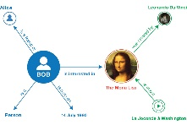
Assumption:
content is always a RDF graph
send
received
1
2
3
Generates a representation of the content
Transmits
the message via the internet
Decodes and get understanding
sender
medium
receiver
Correct Content Conveyance iif:
The RDF graph the sender encodes is equivalent to the RDF
graph the receiver obtained after decoding the message

Slide 66


Content Representation
RDF Graphs
Typed octet streams
M. Lefrançois, RDF presentation and correct content conveyance for legacy services and the web of things. In Proc. IOT'18

Slide 67
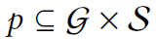
RDF Presentations
RDF Graphs
Typed octet streams
RDF Presentation

Slide 68
Lifting, lowering, validating
Lowering
Validation
Representation validation
Lifting
RDF Graphs
Typed octet streams
Lifting rule maps all the tos in p to their corresponding graph (unique)
Lowering rule maps all the graphs in p to a *chosen* corresponding typed stream
Validation rule checks if there is a pair with that graph
Representation validation rule checks if there is a pair with that tos

Slide 69
+ categorisation of tools
+ analysis of RDF formats
Lowering
- STTL
- SPARQL-Generate
- ad hoc code...
Validation
- SHACL
- ShEx
- SPIN
- ad hoc code...
Representation validation
- JSON Schema
- XML Schema
- ad hoc code...
Lifting
- XSLT
- Triplifiers
- SPARQL-Generate
- RML
- ad hoc code...
RDF Graphs
Typed octet streams
M. Lefrançois, RDF presentation and correct content conveyance for legacy services and the web of things. In Proc. IOT'18

Slide 70
Usage scenarios on the Web
send
The sender can be…
Req/Res: client sends some content to the server
Req/Res: server responds to the client
Pub/Sub: client broadcasts some content to its subscribers
Both agents can also…
be constrained in some ways (battery, storage, comput,…)
implement some of the principles we devise (be semantically flexible)
rely on a third party to operate lifting/lowering/…
sender
receiver
M. Lefrançois, RDF presentation and correct content conveyance for legacy services and the web of things. In Proc. IOT'18

Slide 71
Scenario 1: server/publisher sends its message to a client/subscriber
send
initiates interaction
How to lift ?
I lowered this way, just lift accordingly
server/
publisher
client/
subscriber
receiver discovers how to lift (from the sender, or elsewhere)
sender can be constrained… / receiver can be constrained…

Slide 72
Scenario 2: A client asks a server for the representation of a resource
send
I will lift this way, please lower accordingly
initiates interaction
How to lower ?
server
client
server discovers a presentation suitable for the client
client can be constrained… / server can be constrained…

Slide 73
Scenario 3: A client sends some encoded content to a server
send
I will lift this way, please lower accordingly
initiates interaction
How to lower ?
client
server
client discovers a presentation suitable for the server
client can be constrained… / server can be constrained…

Slide 74
Take away message
RDF Transformation Language
Use it and contribute
Not just a tool
Maxime Lefrançois
Maxime.Lefrancois@emse.fr
http://maxime-lefrancois.info/
MINES Saint-Étienne – Institut Henri Fayol
Laboratoire Hubert Curien UMR CNRS 5516
Ontologies, langages, tools,
to ease the usage of RDF as a lingua franca

Slide 75
Saint-Étienne

Slide 76
Assumption:
content is always a RDF graph
send
received
ontologies
1
2
3
Generates a representation of the content
Transmits
the message via the internet
Decodes and get understanding
sender
medium
receiver

Slide 77


Ontologies, contribution to standardization
SOSA/SSN ontology
Standard OGC et W3C
A. Haller, K. Janowicz, S. Cox, D. Le Phuoc, K. Taylor, M. Lefrançois, Semantic Sensor Network Ontology, W3C Recommendation, W3C, 19 October 2017

Slide 78


Ontologies, contribution to standardization
BOT ontology
M. H. Rasmussen, M. Lefrançois, G. F. Schneider, P. Pauwels, BOT: the Building Topology Ontology of the W3C Linked Building Data Group (submitted May 2019 to Semantic Web Journal)

Slide 79










Ontologies, contribution to standardization
SAREF + influences
HVAC
Smart Grid
Core of SEAS
Ontology patterns
Simple
Smart Home
Transport
Building
http://saref.etsi.org/
@prefix seas: <http://w3id.org/seas/>.
SAREF patterns
+ instances
ETSI STF 556: Consolidation of SAREF and its community of industrial users, based on the experience of the EUREKA ITEA 12004 SEAS
ETSI STF DP: Specification of the SAREF development framework and workflow, and development of the Community SAREF Portal for user engagement

Slide 80

Ontologies, contribution to standardization
A work-in progress at international level
N. Seydoux, M. Lefrançois, L. Médini, . F. Schneider, P. Pauwels, Positionnement sur le Web Sémantique des Objets, Ingénierie des Connaissances 2019 (best paper award)

